Slide 1
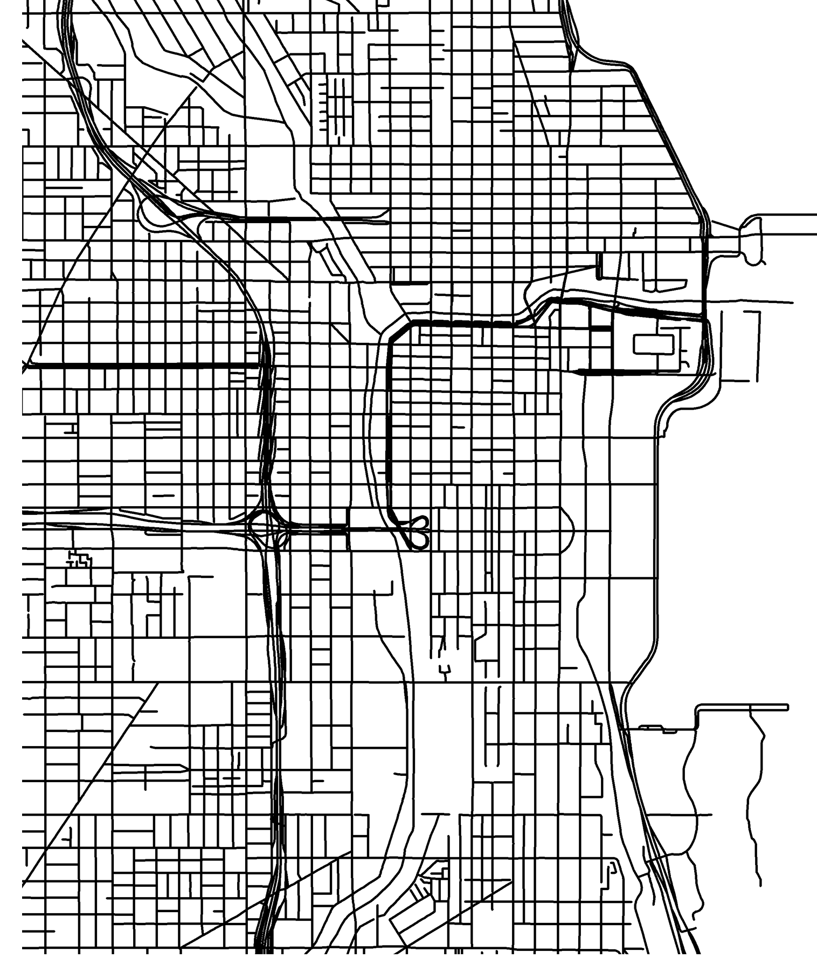
Smart Cities
Felipe Coelho, Katy Liang, Sandra Tacina

Slide 2

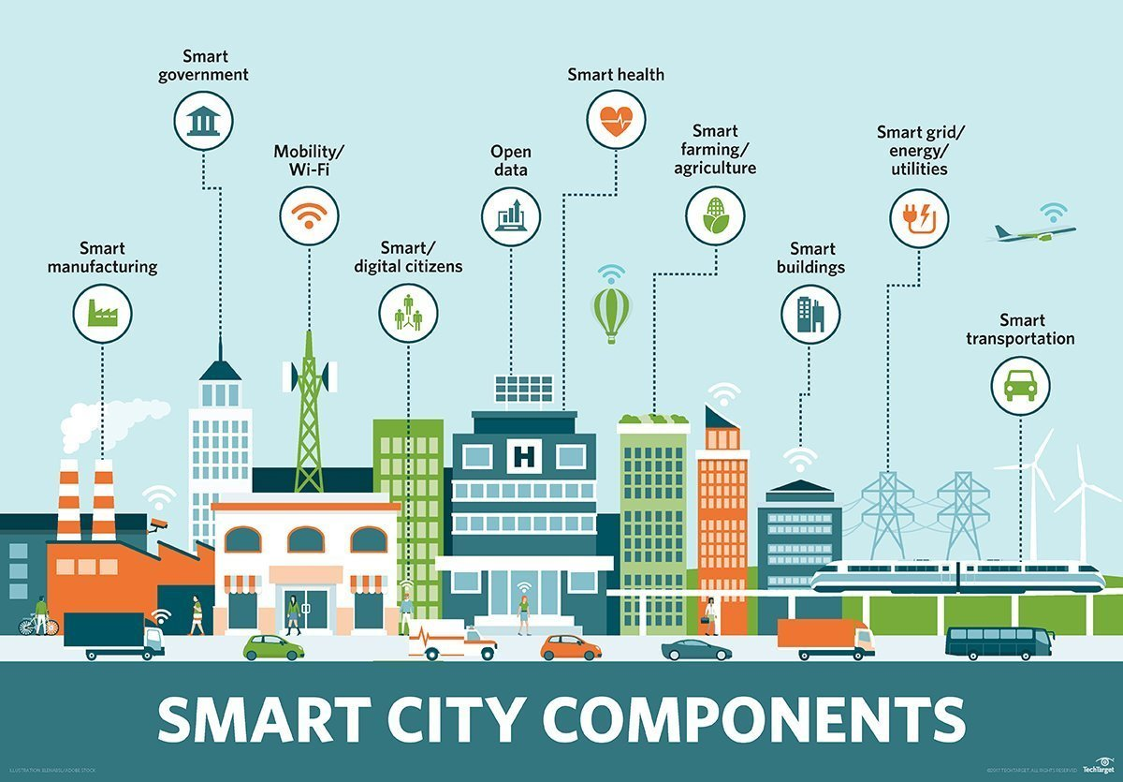
What is a smart city?
“A smart city is a municipality that uses information and communication technologies to increase operational efficiency, share information with the public and improve both the quality of government services and citizen welfare.”
To better plan a smart transportation system we need to understand the demographics of the population of whom we are planning.
Source: techtarget.com
Notes:
Filipe
Define the core message or hypothesis of your project.
Describe the questions you asked, and why you asked them

Slide 3

Questions
Does the accessibility of an area affect the economic makeup of the population?
House value
Income
Poverty
Notes:
All
Elaborate on the questions you asked, describing what kinds of data you needed to answer them, and where you found it
Describe whether you were able to answer these questions to your satisfaction, and briefly summarize your findings

Slide 4

Data Exploration
Data Sources
WalkScore
Census
Cook County
Zillow
Scope of Analysis
Chicago – 57 zipcodes
Notes:
All

Slide 5

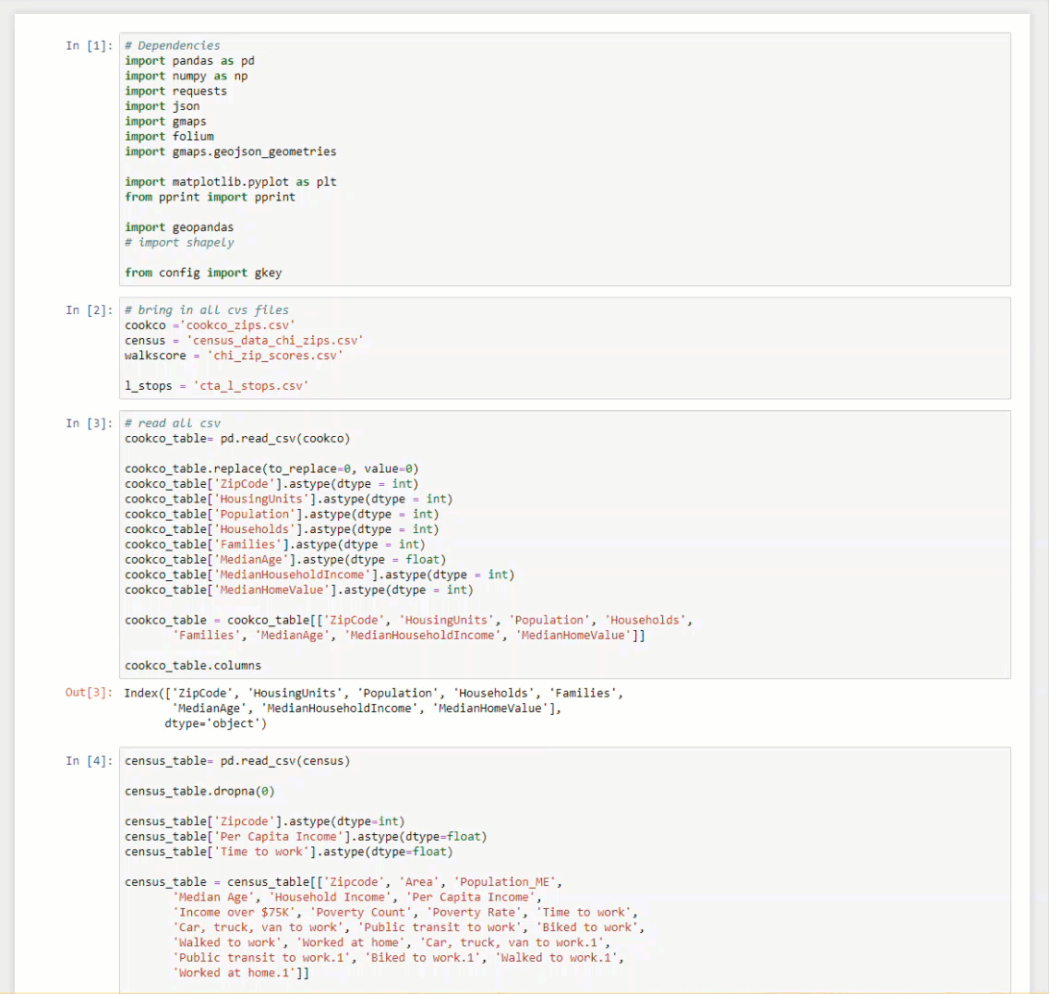
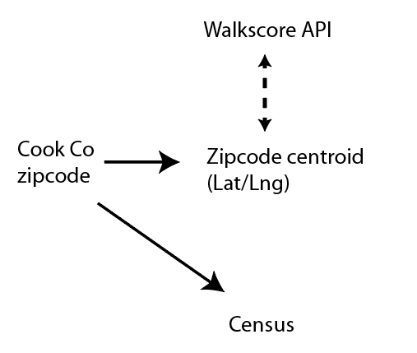
Data Pull + Analysis
Notes:
Katy
Discuss the steps you took to analyze the data and answer each question you asked in your proposal
Present and discuss interesting figures developed during analysis, ideally with the help of Jupyter Notebook

Slide 6

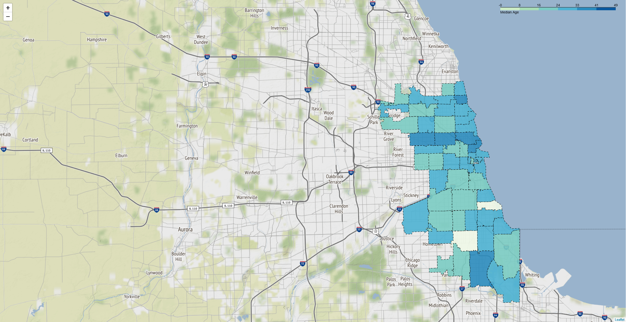
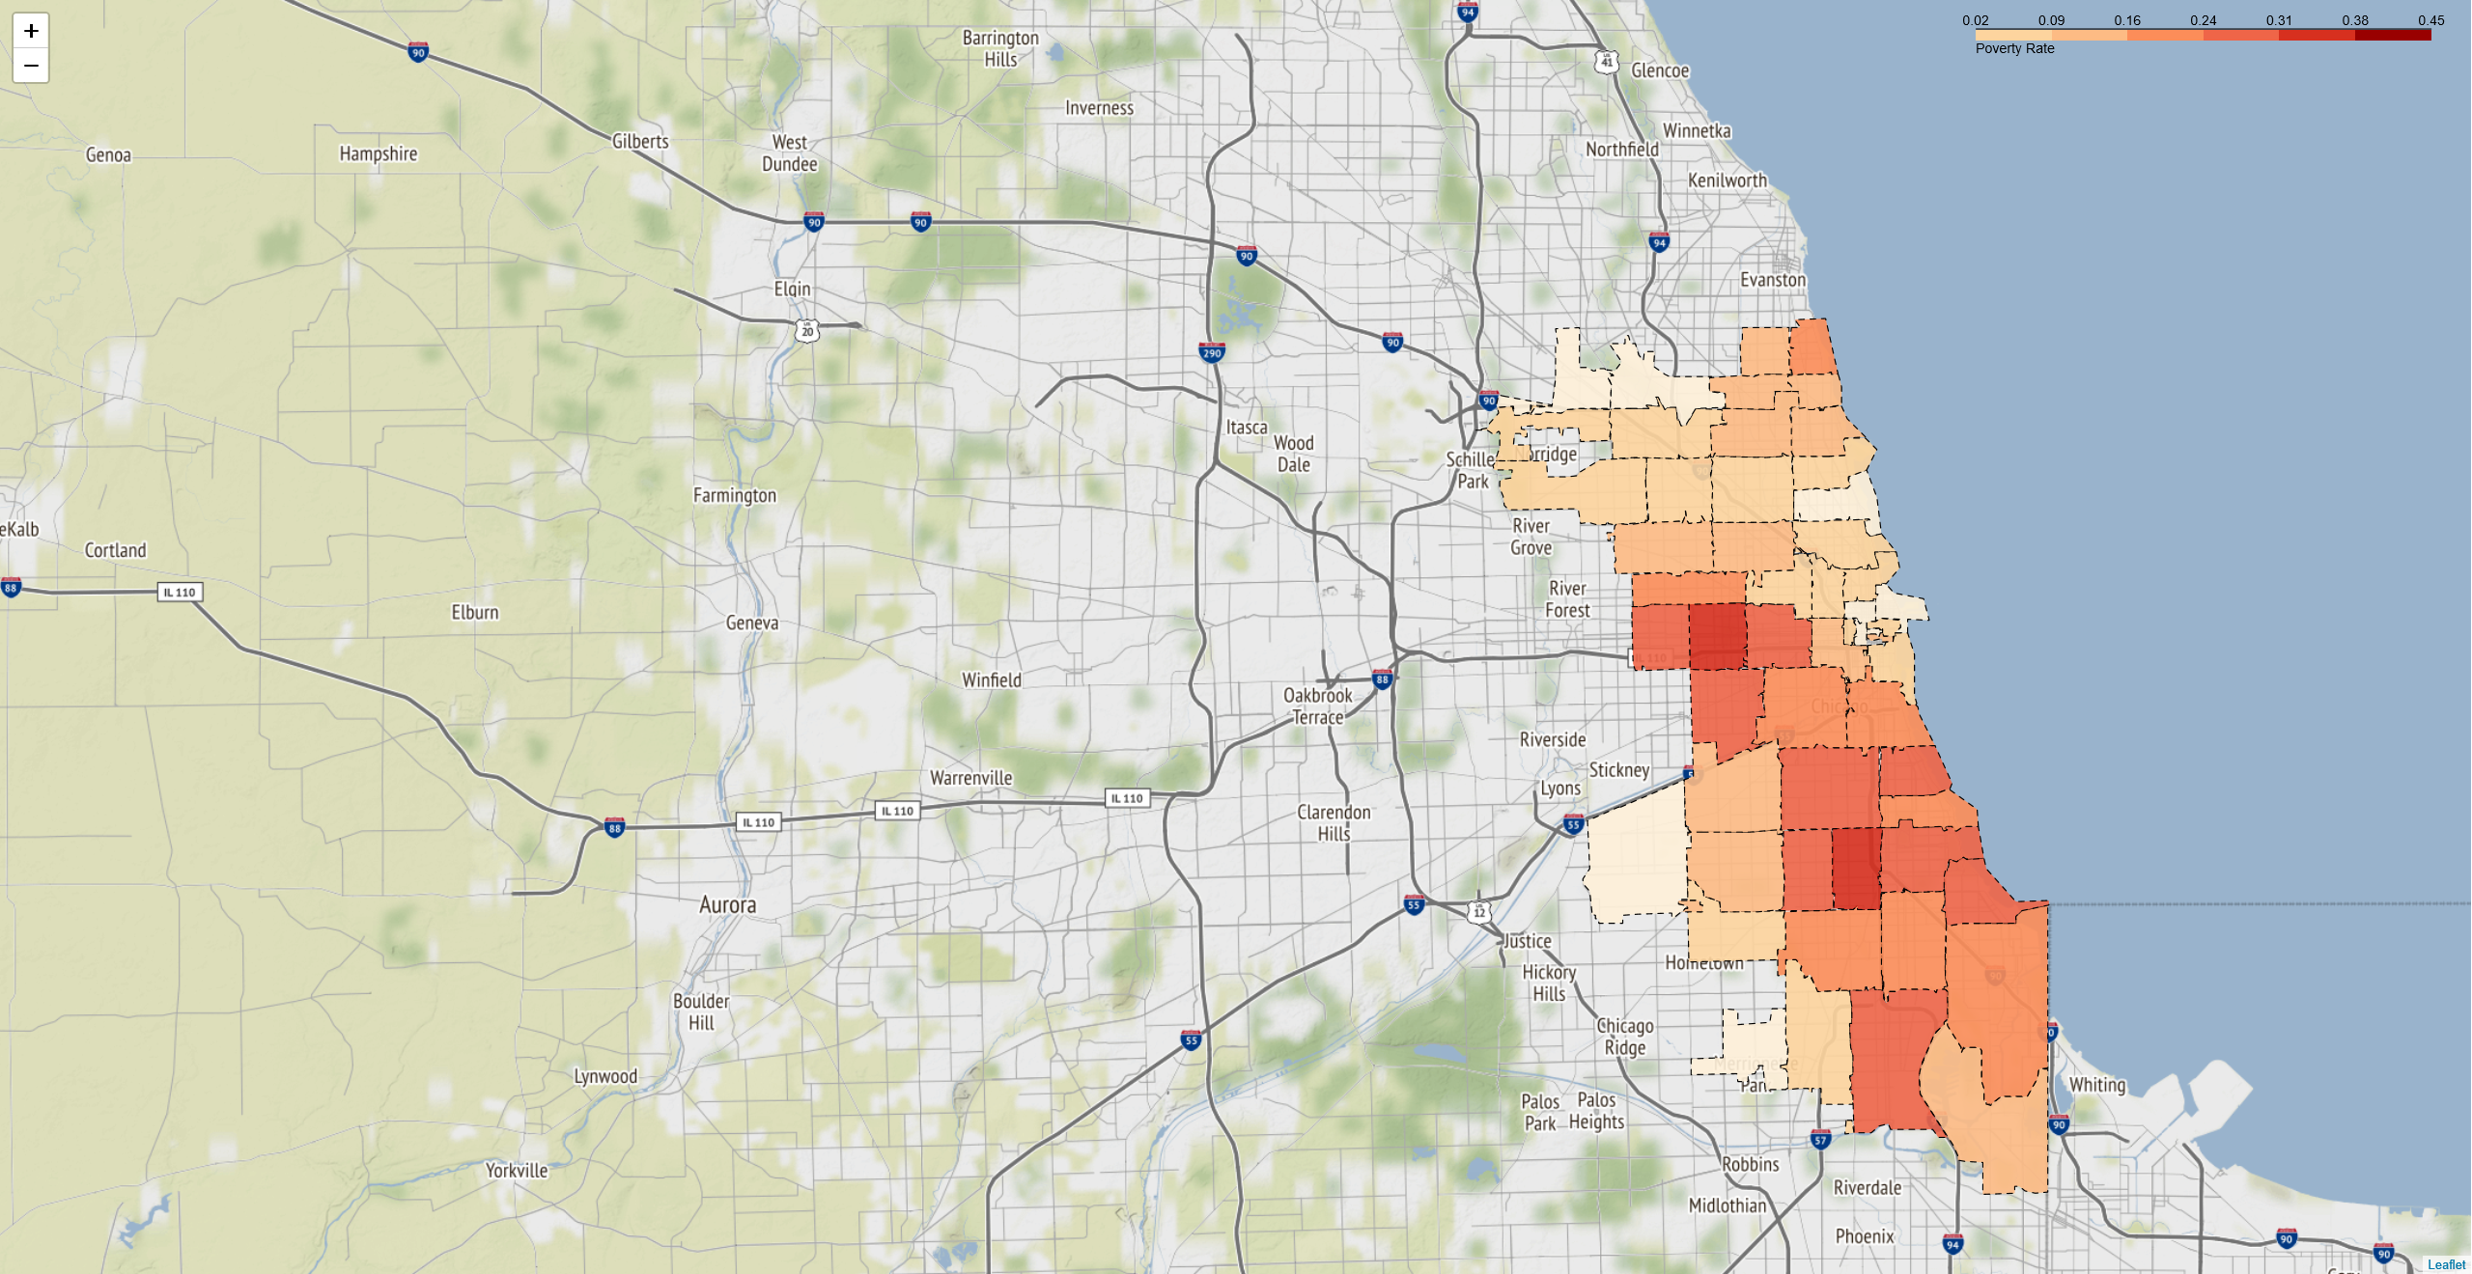
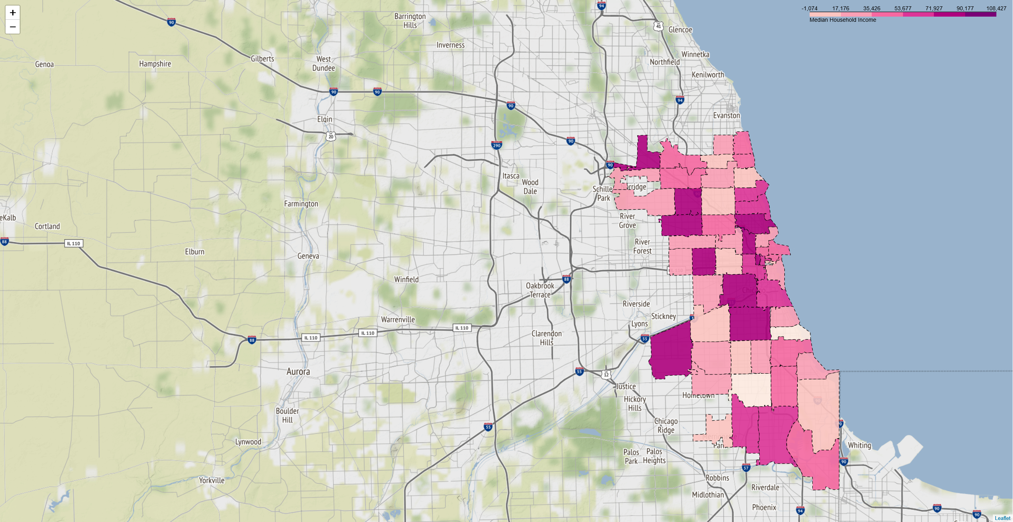
Discussion | demographics
Median: 34
Min: 26
Max:: 49
Median: 19%
Min: 3%
Max:: 45%
Median: $54K
Min: $19K
Max:: $107K
Median Age by zip code
Poverty Rate by zip code
Median Household income by zip code
Notes:
Katy
Discuss your findings. Did you find what you expected to find? If not, why not? What inferences or general conclusions can you draw from your analysis?

Slide 7
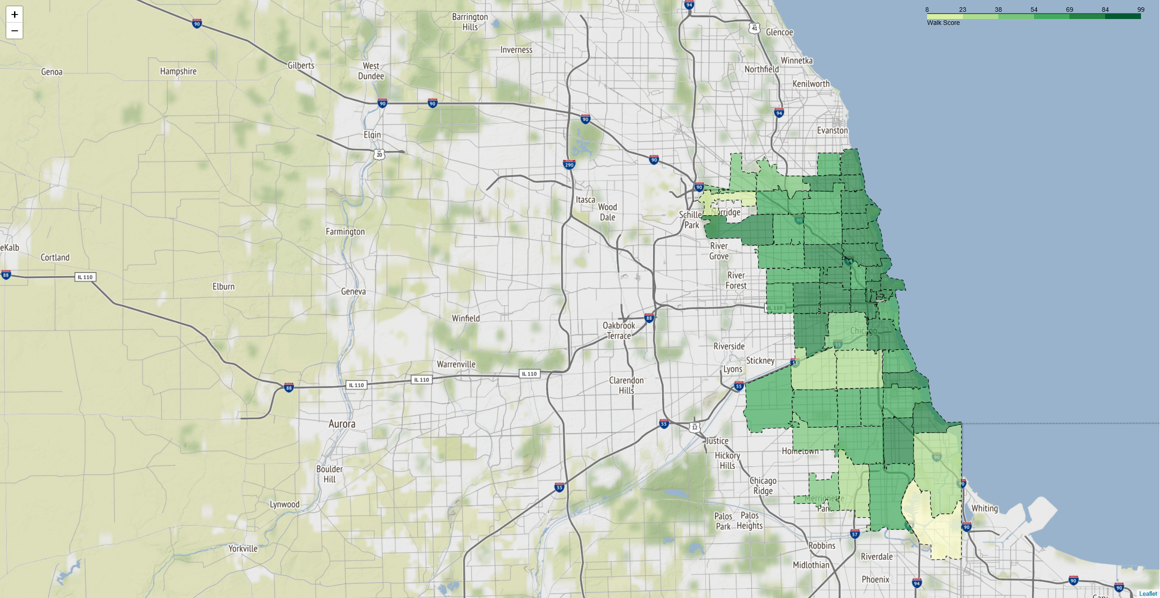
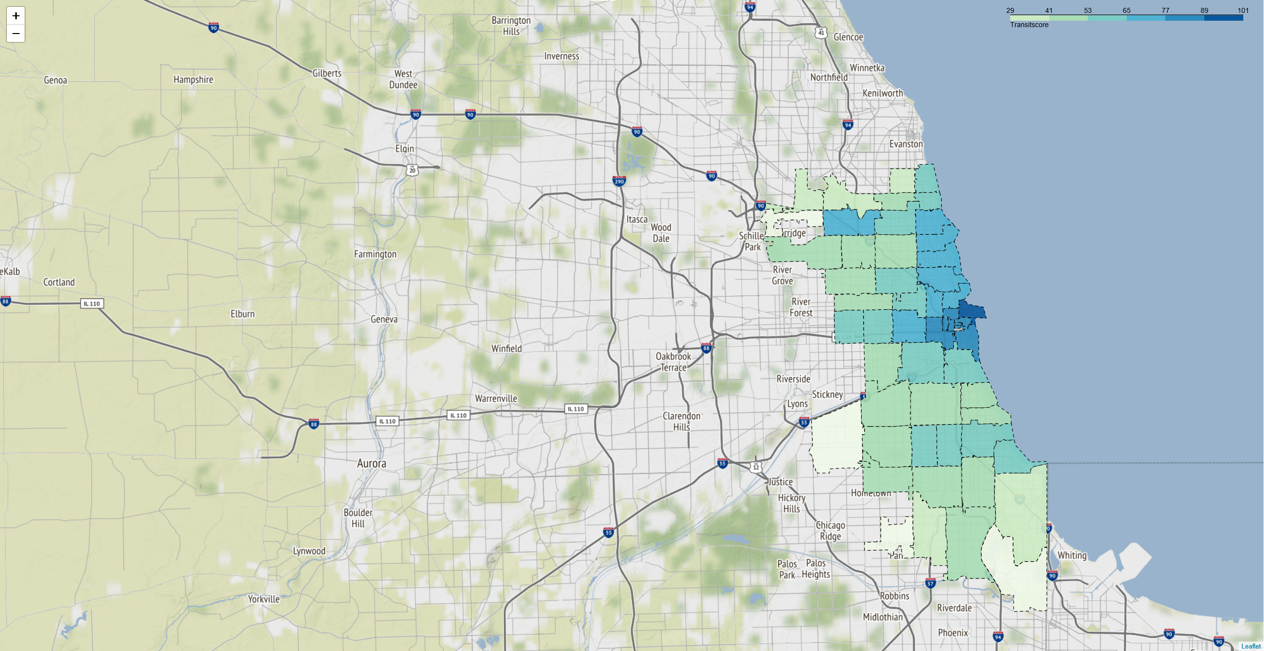
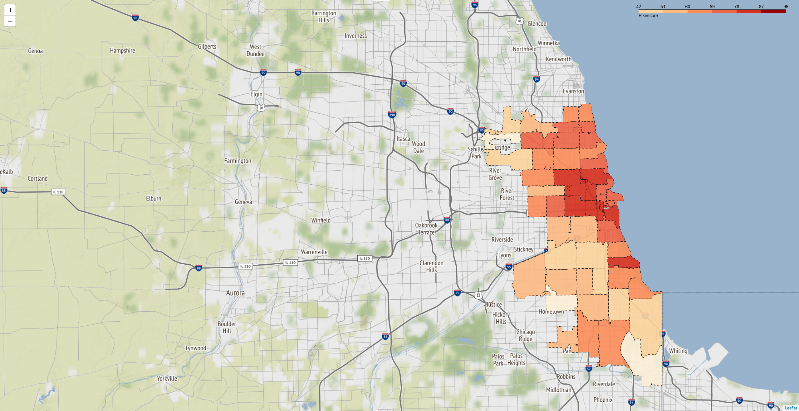
Discussion | walk, transit, bike
Median: 83
Min: 9
Max: 98
Median: 67
Min: 30
Max: 100
Median: 76
Min: 43
Max: 95
Walkscore by zip code
Transitscore by zip code
Bikescore by zip code
Notes:
Katy

Slide 8
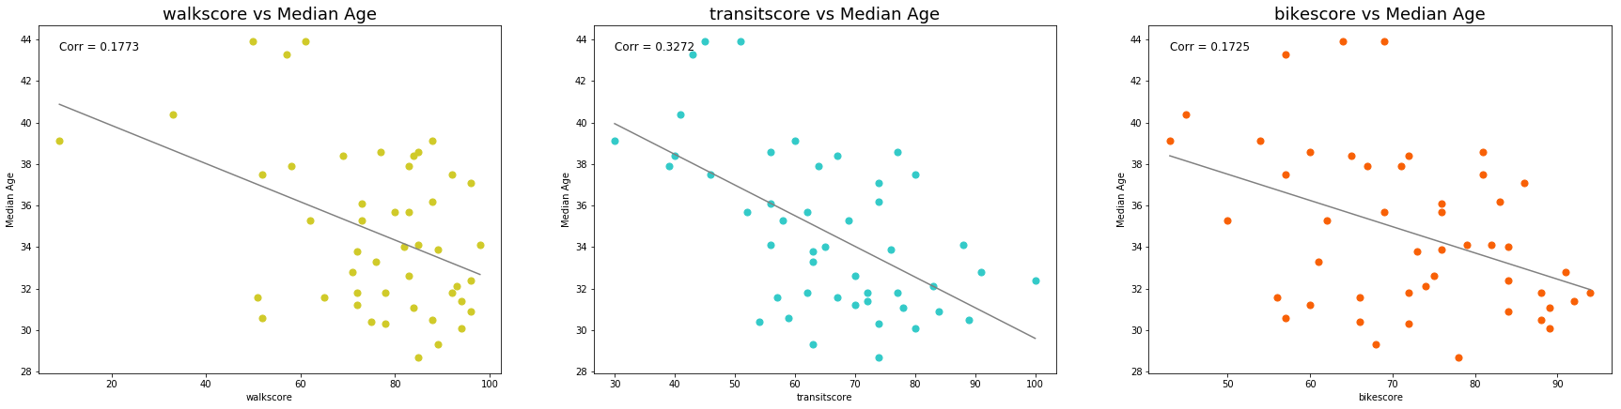
Discussion | median age
Notes:
Filipe

Slide 9
Discussion | age distribution by walkscore
Age Distribution by Walkscore Band
 | Walkscore Band
Age Band | <51 | 51-65 | 66-80 | 81-95 | >95
<9 | 11.3% | 13.6% | 13.7% | 11.4% | 6.2%
10-19 | 12.0% | 13.9% | 12.8% | 10.6% | 5.7%
20-29 | 11.0% | 14.4% | 16.4% | 20.7% | 30.2%
30-39 | 14.6% | 13.2% | 16.5% | 17.7% | 23.7%
40-49 | 13.0% | 13.7% | 12.8% | 12.5% | 11.9%
50-59 | 15.6% | 13.0% | 11.7% | 11.5% | 9.0%
60-69 | 10.6% | 9.1% | 8.7% | 8.3% | 8.6%
>70 | 12.0% | 9.1% | 7.5% | 7.3% | 4.7%
walkscore
Chi Square test
P value <0.001
Notes:
Filipe

Slide 10
Discussion | age distribution by transitscore
Age Distribution by TransitScore Band
 | TransitScore Band
Age Band | <51 | 50-64 | 65-79 | 80-94 | >95
<9 | 11.4% | 14.2% | 12.7% | 8.0% | 5.5%
10-19 | 11.1% | 13.6% | 11.8% | 6.4% | 6.9%
20-29 | 13.0% | 15.1% | 18.9% | 28.2% | 31.7%
30-39 | 14.4% | 14.4% | 17.5% | 22.9% | 23.1%
40-49 | 13.4% | 12.9% | 12.4% | 11.5% | 13.2%
50-59 | 14.1% | 12.6% | 11.4% | 9.1% | 9.2%
60-69 | 11.0% | 9.1% | 8.2% | 7.4% | 7.2%
>70 | 11.6% | 8.0% | 7.1% | 6.4% | 3.2%
transitscore
Chi Square test
P value <0.001
Notes:
Filipe

Slide 11
Discussion | age distribution by bikescore
Age Distribution by BikeScore Band
 | Bikescore Band
Age Band | <50 | 50-64 | 65-79 | >80
<9 | 11.5% | 13.8% | 14.1% | 8.3%
10-19 | 11.0% | 13.8% | 13.2% | 7.8%
20-29 | 11.5% | 13.9% | 16.4% | 25.7%
30-39 | 16.5% | 12.7% | 15.0% | 22.0%
40-49 | 13.0% | 13.1% | 12.8% | 12.3%
50-59 | 15.0% | 13.3% | 12.1% | 10.0%
60-69 | 10.5% | 9.7% | 8.8% | 7.9%
>70 | 11.0% | 9.7% | 7.7% | 5.9%
bikescore
Chi Square test
P value =0.03
Notes:
Filipe

Slide 12
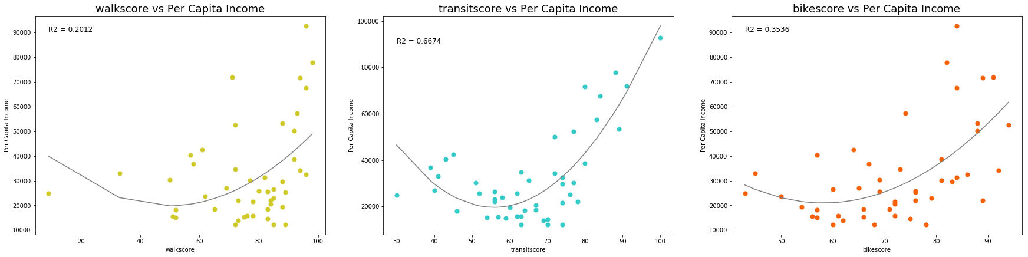
Discussion | per capital income
Notes:
Filipe

Slide 13
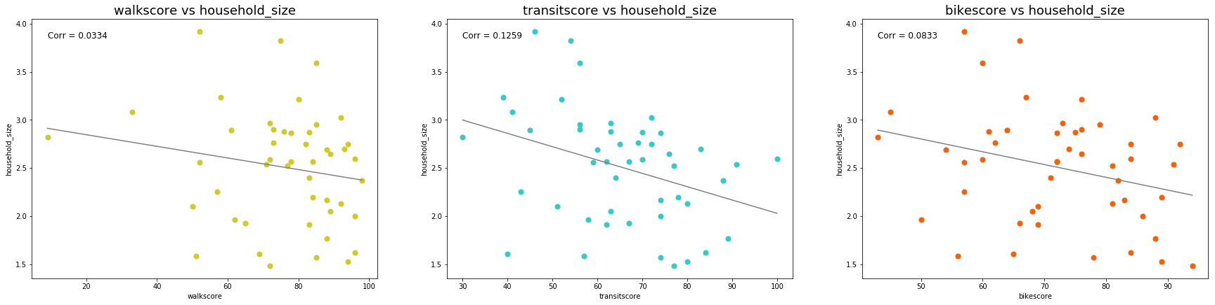
Discussion | household size
Notes:
Filipe

Slide 14
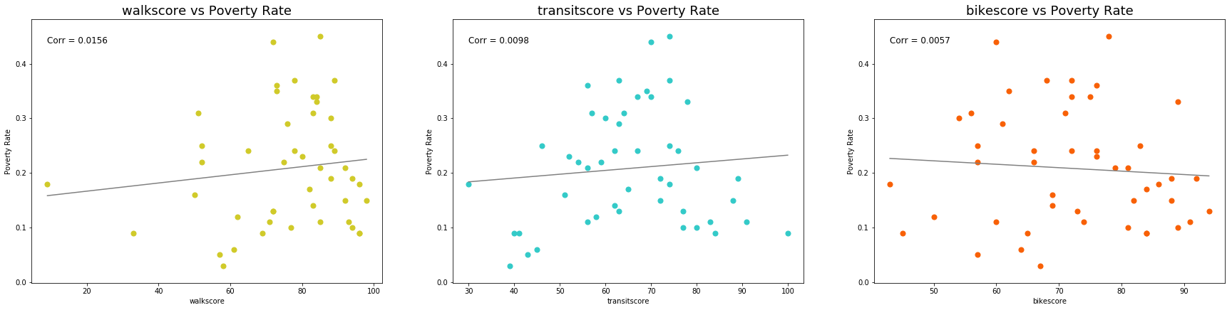
Discussion | poverty rate
To transit varies significantly by neighborhood, and high income neighborhoods have better access.
However, the converse is not true: there is no evidence that, on average, people living in poverty less have less access to transit or live in areas that are less walkable/bikible
Notes:
FIlipe

Slide 15
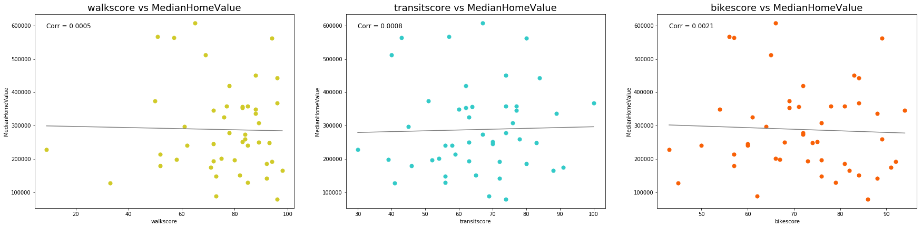
Discussion | home value
Notes:
Filipe

Slide 16
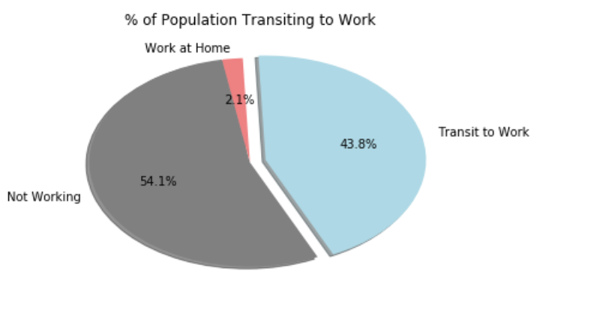
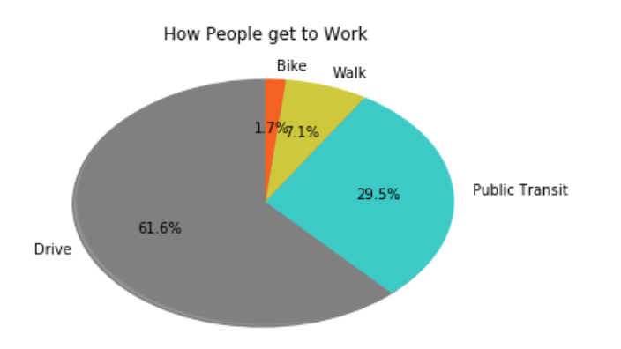
Discussion | commuting
Only a portion of Chicagoans report commuting to work
Of those that do commute, most people drive to work
Notes:
Sandra

Slide 17
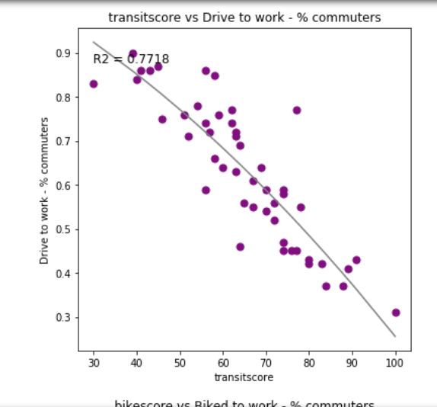
Discussion | commuting
In Chicago neighborhoods with a higher transit scores, people are much less likely to drive to work
Notes:
Sandra

Slide 18
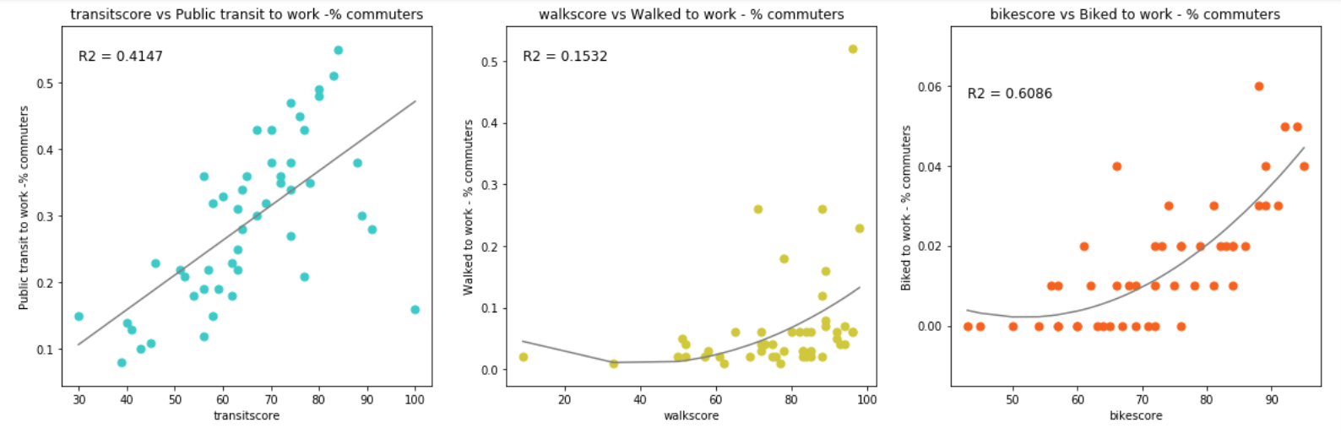
Discussion | commuting
The number of people taking public transit increases dramatically with transit score
While increased walk scores do correlate with more people walking, this option is only viable for individuals working close to home
While only a fraction of people bike to work, those living in areas with a higher bike score are more likely to do so
Notes:
Sandra

Slide 19
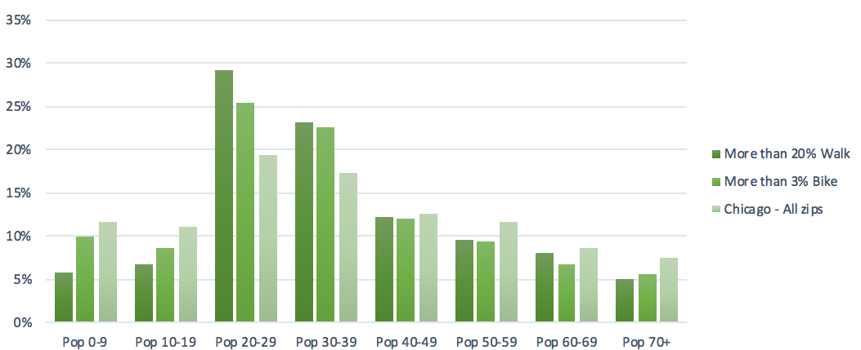
Discussion | commuter patterns
How do areas where the greatest portion of people walk or bike look different the Chicago overall?
More than 20% of commuters walk
More than 3% of commuters walk
Areas with more people commuting via bike and by foot have higher bike scores and walk scores, respectively
Areas with more people commuting via bike and by foot have more people in the 20's and 30's
 | walkscore | transitscore | bikescore
More than 20% Walk | 91.90 | 96.44 | 85.70
More than 3% Bike | 84.91 | 77.55 | 86.09
Chicago - All zips | 78.05 | 68.39 | 73.75
x
Areas where more people walk to work have a higher average income.
Areas with more bikes have a slightly higher average income
 | Average income
More than 20% Walk | $ 64,687
More than 3% Bike | $ 59,988
Chicago - All zips | $ 57,835
~50% of the population with high levels of walking / biking are in there 20's and 30's compared to only 37% of the overall populations

Slide 20


Post Mortem | challenges
Lots of data available
Choosing where to focus
Notes:
Sandra + Katy
Discuss any difficulties that arose, and how you dealt with them
Discuss any additional questions that came up, but which you didn't have time to answer: What would you research next, if you had two more weeks?

Slide 21
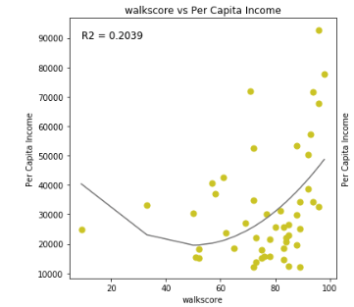
Post Mortem | what next?
Look outside
Look at data over time
Using google maps could we create our own walkscore and compare it to the one we used?
Notes:
All
Discuss any difficulties that arose, and how you dealt with them
Discuss any additional questions that came up, but which you didn't have time to answer: What would you research next, if you had two more weeks?

Slide 22

Questions?

Slide 23
requirements
Be at least 8-10 min. long
Describe the core message or hypothesis for your project.
Describe the questions you and your group found interesting, and what motivated you to answer them
Summarize where and how you found the data you used to answer these questions
Describe the data exploration and cleanup process (accompanied by your Jupyter Notebook)
Describe the analysis process (accompanied by your Jupyter Notebook) Summarize your conclusions. This should include a numerical summary (i.e., what data did your analysis yield), as well as visualizations of that summary (plots of the final analysis data)
Discuss the implications of your findings. This is where you get to have an open-ended discussion about what your findings "mean".
Tell a good story! Storytelling through data analysis is no different than in literature. Find your narrative and use your analysis and visualization skills to highlight conflict and resolution in your data

